Slide 1
Workshop
Introduction to LibreOffice Development
Part 2
Python Scripting

Slide 2

Hi
Alain Romedenne
alain.romedenne@libreoffice.org
LibreOfficiant
LOfficiant
Python scripting made simple with IDE_utils
LibreOffice Basic Hidden Gems
Scripting Python Macros
aka Macros Well Kept Secrets

Slide 3
Python Scripting - agenda
Why Python ?
Embedded dev. w/ APSO
Remote dev. & debugging
Officehelper.py bridge
IDE_utils use case
Programming examples
Python data crunching
My 2 cents
Bonus : PyPI
Extensions worth looking at
e-references
bibliography
Notes:
Please Q&A at the end

Slide 4
Why Python ?
LibreOffice BASIC
Integrated IDE
Documentation
MS-Office to LibreOffice
VBA-like facilities
Python
Ubiquitous prog. language
Maps to BASIC UNO samples
Source explorer, syntax hiliting, code completion, debugging, PEP guidelines, test-driven dev, version control
Rich ecosystem
Notes:
Basic prior knowledge not necessary
BASIC UNO examples translate easily to Python
Different Python context to overcome:
Embebbed execution
User local storage not in %PATH
No runtime from Start Center vs. LO BASIC
CLI Command Line Interface
Remote IDEs
IDE & LibO must be bridged
Start, Stop mechanism
XSCRIPTCONTEXT surrogate

Slide 5

Embedded Python dev.
Alternate Python Script Organizer
intro. to UNO API
Xray guide
MRI guide
Dev tools – Tomaž V’s blog
Notes:
MRI + Xray demos with 24.2_en:
APSO debugger
Run HelloWorldPython
Describe Code, call stack, watch panes
No breakpoints
Enter up to line 28
Double-click to get MRI or Xray
Disable MRI to get Xray
Demo Dev. Tools :
DOM tree view
Object inspection

Slide 6
Remote Python dev. & debugging
Officehelper connection to LibO process
  FirstUnoContact example, core unit tests
uno.py vs. XSCRIPTCONTEXT
Python Basics
IDE_utils repo
Notes:
There’s no Python integrated IDE
A Python integrated may never exists within LibreOffice:
Professional IDE’s are unmatchable
Standard users do not need nor want a Python IDE
Would be to costly to maintain
As many code lines, as important LibreOffice surface attack
None of these are required for LibreOffice to function:
APSO, xray, mri and so on ...
Officehelper.py
IDE_utils.py, OOO Dev. Tools

Slide 7
LibreOffice as a Service
import officehelper
try:
xContext = officehelper.bootstrap()
print("Connected to a running office ...")
xMCF = xContext.getServiceManager()
available = "not available" if xMCF is None else "available"
print("remote ServiceManager is " + available)
except Exception as e:
print(e)
Notes:
CAUTION : That example does not stop the service it initiated
cf. officehelper exception handling code to clone service stopping.

Slide 8
import unittest
from officehelper import bootstrap, BootstrapException
class OfficeHelperTest(unittest.TestCase):
"""officehelper.py must provide:
Support of Windows, Mac OS X & GNU/Linux distributions
Customizable connection with 'delays' **kwarg
Reporting to console with 'report' **kwarg
Memory cleanup from soffice service
"""
def test_default_config(self):
# Check default timeout and number of attempts
# Stop LibreOffice running service
ctx = bootstrap() # Default settings suffice to initialize the service
#time.sleep(10) # gve
if ctx: # stop soffice as a service
smgr = ctx.getServiceManager()
desktop = smgr.createInstanceWithContext("com.sun.star.frame.Desktop", ctx)
desktop.terminate()
self.assertTrue(ctx) # check for failure
def test_kwargs(self):
# Wait differently for LO to start, request context 10 times
# Report processing in console
ctx = bootstrap(delays=[1,]*10, report=print)
if ctx: # stop soffice as a service
smgr = ctx.getServiceManager()
desktop = smgr.createInstanceWithContext("com.sun.star.frame.Desktop", ctx)
desktop.terminate()
self.assertTrue(ctx)
def test_exception(self):
# Raise BootstrapException and stop ALL PRESENT LibreOffice running services
with self.assertRaises(BootstrapException):
bootstrap(delays=[0,], report=print) # delays=[0,] must raise BootstrapException
if __name__ == "__main__":
unittest.main()
Notes:
CAUTION: 2 unit tests out of 3 should stop LibreOffice as a service. TearDown routine is missing.

Slide 9
officehelper.py bridge
Win, Linux, Mac
Random pipe name
Retry/timeout
Alternate LibO program
No XSCRIPTCONTEXT
  uno.py instead
Localhost only
  pipe vs. tcp/ip
see: XSCRIPTCONTEXT vs. uno.py
example: FirstLoadComponent
Notes:
XSCRIPTCONTEXT only available from an open document
Uno.py necessary when:
Importing Python module
Start Center script execution
Remote IDE
tcp/ip to target remote LibO copies
Must-have APSO extension
Note: prepends <user>/Scripts/python to %PATH%

Slide 10
IDE_utils use case
XSCRIPTCONTEXT coding preference
Innocuous code insertion
LibO as a Service automation
LibO remote target
modern IDEs bells & whistles
demos :
  Geany
  Pyzo: breakpoints
  PyCharm: Hello World
  “﻿ IDEs supporting LibO
  embedded Python interpreter ”

Slide 11
Examples
Run Dispatch command
Update Writer TOC/indexes upon Save
‘TableSample’ application script
Manage DB Table relationships
Overcome BASIC limits
Monitor doc. Events

Slide 12
Examples
Disable Menu commands
Execute Calc functions

Slide 13
Run a Dispatch command
import uno
from com.sun.star.beans import PropertyValue as pv
def basicIDE():
dh = _createUnoService('com.sun.star.frame.DispatchHelper')
StarDesktop = _createUnoService('com.sun.star.frame.Desktop')
args = (pv(Name='Document', Value='LibreOffice Macros & Dialogs'), \
pv(Name='LibName',Value='ScriptForge'), \
pv(Name='Name',Value='SF_Session'), \
pv(Name='Line',Value=100))
dh.executeDispatch(StarDesktop.ActiveFrame, '.uno:BasicIDEAppear','', 0, args)
def _createUnoService(svc_name) -> uno:
''' params:
svc_name Service API name e.g. " ..frame.DispatchHelper '''
ctx = uno.getComponentContext()
smgr = ctx.getServiceManager()
return smgr.createInstanceWithContext(svc_name, ctx)
from scriptforge import CreateScriptService
def basicIDE():
ui = CreateScriptService('ui')
ui.RunCommand('BasicIDEAppear', Document = 'LibreOffice Macros & Dialogs', LibName = 'ScriptForge', Name = 'SF_Session', Line = 100)

Slide 14
Update WriterTOC/indexes upon Save
def UpdateIndexes(*args):
"""Update indexes, such as for the table of contents"""
thisComponent = XSCRIPTCONTEXT.getDocument()
if thisComponent.supportsService("com.sun.star.text.GenericTextDocument"):
count = thisComponent.getDocumentIndexes().getCount()
for i in range(0,count):
thisComponent.getDocumentIndexes().getByIndex(i).update()
Notes:
Explain code
Run doc
in Tools – Customize… show OnLoad event
Save with Ctrl+S

Slide 15
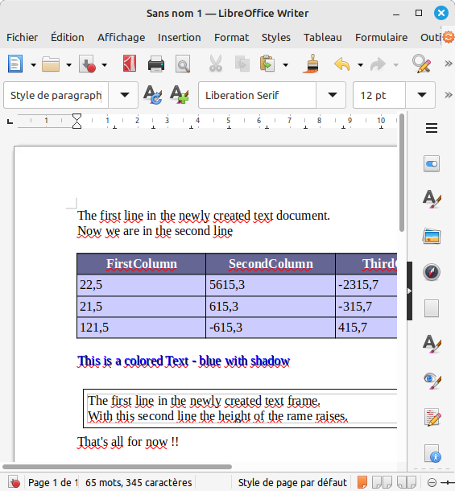
‘Table Sample’ shared script

Slide 16
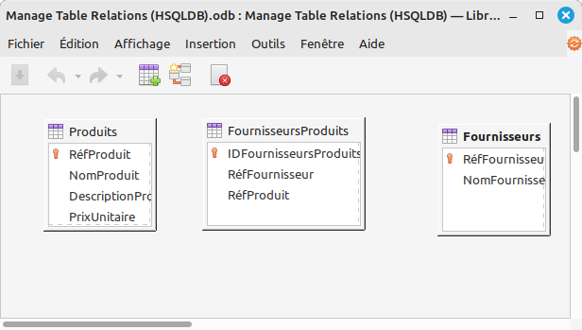
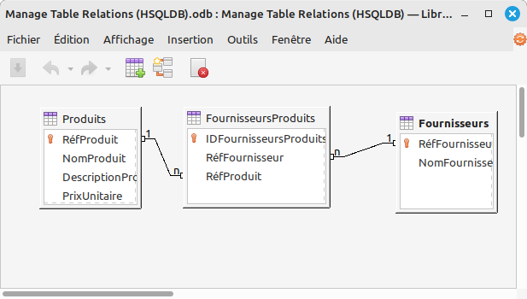
Manage DB Table Relationships 1/3
cf. Create a Relationship in SQL

Slide 17
Manage DB Table Relationships 2/3
def SetRelationships():
from scriptforge import CreateScriptService as getSvc
util = getSvc('ScriptForge.Basic')
connection = util.ThisDatabaseDocument.DataSource.getConnection('','')
tbl = connection.Tables.getByName('FournisseursProduits')
# suppress existing indexes
for x in range(tbl.Keys.Count-1, -1,-1):
tbl.Keys.dropByIndex(x)
# suppress existing indexes
for x in range(tbl.Keys.Count-1, -1,-1):
tbl.Keys.dropByIndex(x)
# primary key creation
pk = tbl.Columns.getByName('IDFournisseursProduits')
desc = tbl.Keys.createDataDescriptor()
desc.Type = PRIMARY
desc.Columns.appendByDescriptor(pk)
tbl.Keys.appendByDescriptor(desc) # add to index
Transposed from BASIC Gérer les Relations entre Tables

Slide 18
Manage DB Table Relationships 3/3
# create relation with 'Fournisseurs' table
fk = tbl.Keys.createDataDescriptor()
ID_col = fk.Columns.createDataDescriptor()
ID_col.Name = 'RéfFournisseur'
ID_col.Type = FOREIGN
ID_col.RelatedColumn = 'RéfFournisseur'
fk.Type = FOREIGN
fk.ReferencedTable = 'Fournisseurs'
fk.UpdateRule = NO_ACTION
fk.DeleteRule = NO_ACTION
fk.Columns.appendByDescriptor(ID_col)
tbl.Keys.appendByDescriptor(fk) # add to index
# create relation with 'Produits' table
fk = tbl.Keys.createDataDescriptor()
ID_col = fk.Columns.createDataDescriptor()
ID_col.Name = 'RéfProduit'
ID_col.Type = FOREIGN
ID_col.RelatedColumn = 'RéfProduit'
fk.Type = FOREIGN
fk.ReferencedTable = 'Produits'
fk.UpdateRule = NO_ACTION
fk.DeleteRule = NO_ACTION
fk.Columns.appendByDescriptor(ID_col)
tbl.Keys.appendByDescriptor(fk) # add to index
Transposed from BASIC Gérer les Relations entre Tables

Slide 19
Overcome BASIC/Python limits
Input(), repr(),
print(), str()
X-scripting in help
Basic, FileSystem, Session ScriptForge services
ComputerName
File size 2 GB limit
cf. Output to Python console on wiki
cf. Input/Output to Screen on wiki

Slide 20
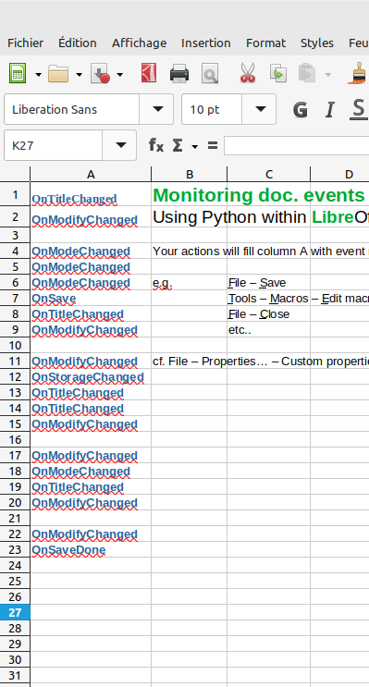
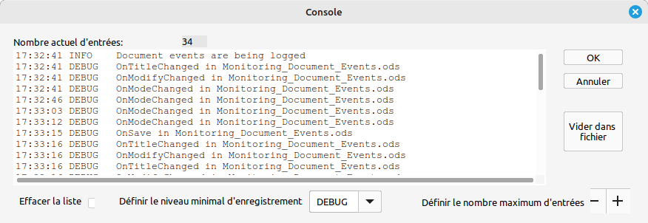
Monitor doc. events
cf. Monitoring document events in wiki

Slide 21
Disable Menu Commands
Menu | UNO command
File – Open Remote... | .uno:OpenRemote
File – Quit | .uno:Quit
Edit – Select All | .uno:SelectAll
Help – About LibreOffice | .uno:About
11
Transposed to Python & BASIC from Java Disable commands example

Slide 22
Python data crunching
Calc Functions & Charting
  database, date & time, finance, maths, text, stats, ..
  rows & columns limits
Data Analysis & Visualization
  Matplotlib, NumPy, Pandas, SciPy, ..
  Database access w/ UNO SDBC
e.g. Data Analysis w/ Python

Slide 23
my 2 cents – don’t code !
Study Python LibreOffice Programming, Introduction to the API, Dev Guide Prof. UNO
& Basic Guide, Macros Explained by A. Pitonyak
know Dispatcher commands
Learn Calc functions, UNO API namespaces
grab ScriptForge doc. & examples
Note: do not clutter LibO w/ Python ecosystem
or w/ Python dev. environment
Notes:
Validate your scripts in a std. LibreOffice context :
Disable APSO
Uninstall xRay
Disable MRI
Disable the rest:
OOO Dev Tools,
LibrePythonista,
you name it…
One can clutter his/her personal environment, but an office shared one.

Slide 24
Extensions worth looking at ...
APSO - Alternative Python Script Organizer
Xray
MRI- My Reflection & Introspection
Code Highlighter
Include Python Path ...
Zaz-pip,
APSO with_pip
LibrePythonista - repo
databases access
cf. How to Run Pip From The Python Interactive Shell

Slide 25
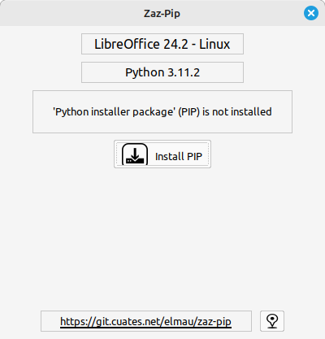
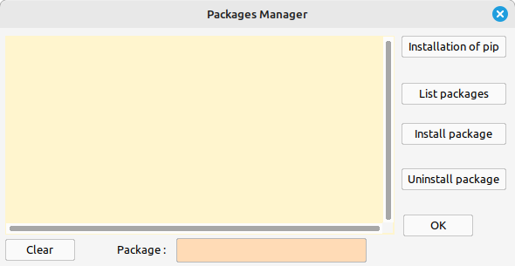
Extensions worth looking at ...
Include Python Path ...
Zaz-pip,
APSO with_pip
LibrePythonista - repo
databases access
cf. How to Run Pip From The Python Interactive Shell

Slide 26
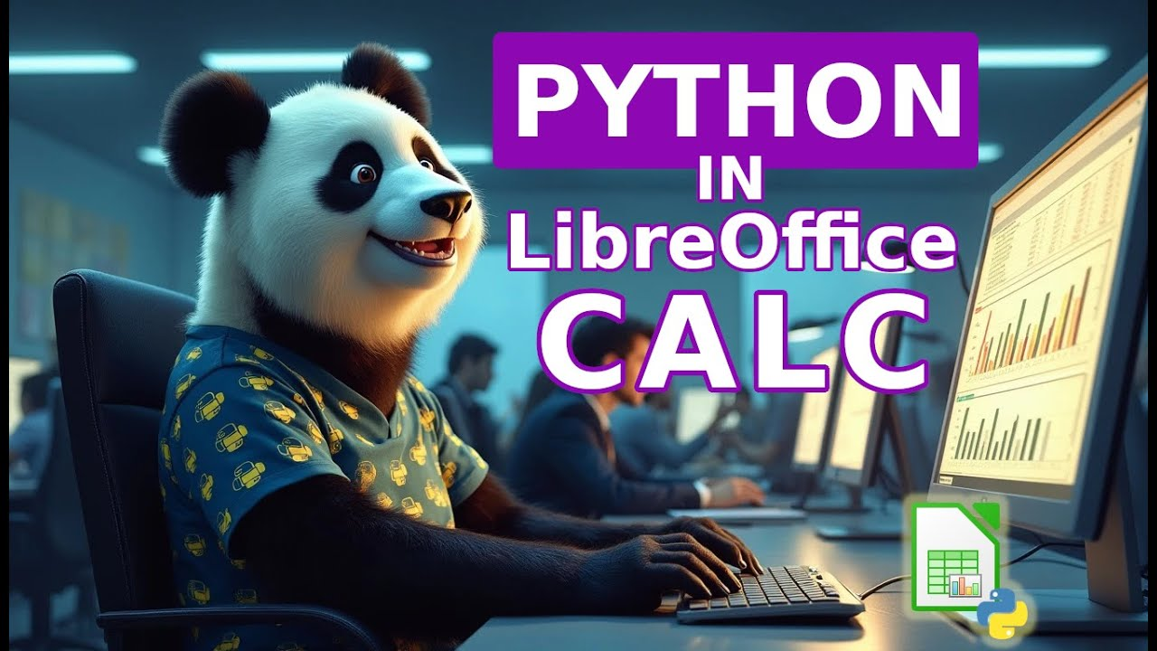
Bonus

Slide 27
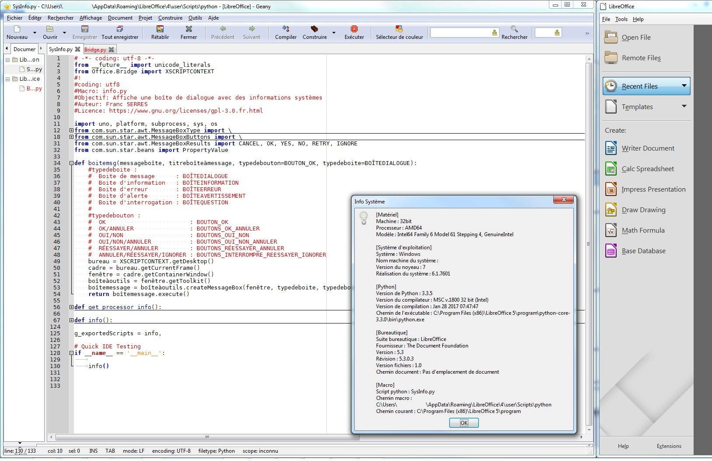
e-references
Python design guide
on TDF wiki
Python Basics,
Xray, MRI
extensions
Geany,
PyCharm,
Pyzo IDEs

Slide 28
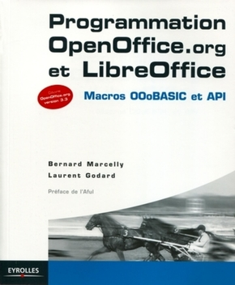
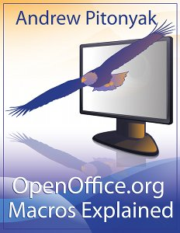
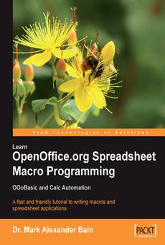
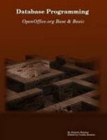
Bibliography
“Developer’s Guide 4.0” A. Pitonyak – 683p. c.2018
“Programmation LibreOffice” B. Marcelly, L. Godard – 926p. c.2010
“Database Programming” Roberto Benitez – 349p. c.2008
“Spreadsheet Macro Programming” M. A. Bain – 220p. c.2006

Slide 29
Thanks
&
Happy Python !
LibO bookshelf
help, wiki, API ref.
Ask
LibO Macros & Scripting
on Telegram

Slide 30
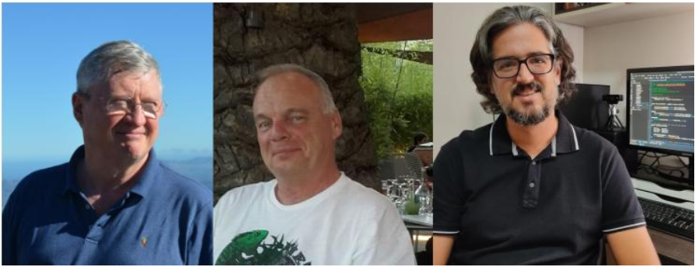

ScriptForge team
Jean-Pierre Ledure, Rafael Lima, Alain Romedenne
Documentation
    https://help.libreoffice.org/latest/en-US/text/
    sbasic/shared/03/lib_ScriptForge.html
ScriptForge Sources
    https://gitlab.com/LibreOfficiant/scriptforge
Type Support (typings) for ScriptForge, by PauL Moss.
    https://github.com/Amourspirit/python-types-scriptforge

